Slide 1

TRENDING APPS DETECTION
Kate Mizgireva • Katie Balcewicz • Zach Kidd
Data Science Data Science Data Science
MUSC Data Science Intern Office of Admissions Student Student
Data Model Builder

Slide 2
Web scrape data from Apple and Android App Stores
Detect the outlier trending apps
Message N3TWORK about top trends
PROJECT DESCRIPTION

Slide 3

CAYCE
Trend sPotter

Slide 4










TECHNOLOGIES USED
repository, scrum management communication, updates, tracking database
storage, hosting virtual machine web scraping
daily scripts main scripts predictive modeling data collections

Slide 5
PROJECT PIPELINE
Web-scrape using Node.js
Automate web-scraping using BASH
Load into MongoDB
Build Pandas DataFrames
Predict trending apps using outlier detection
Code Slack Bot

Slide 6
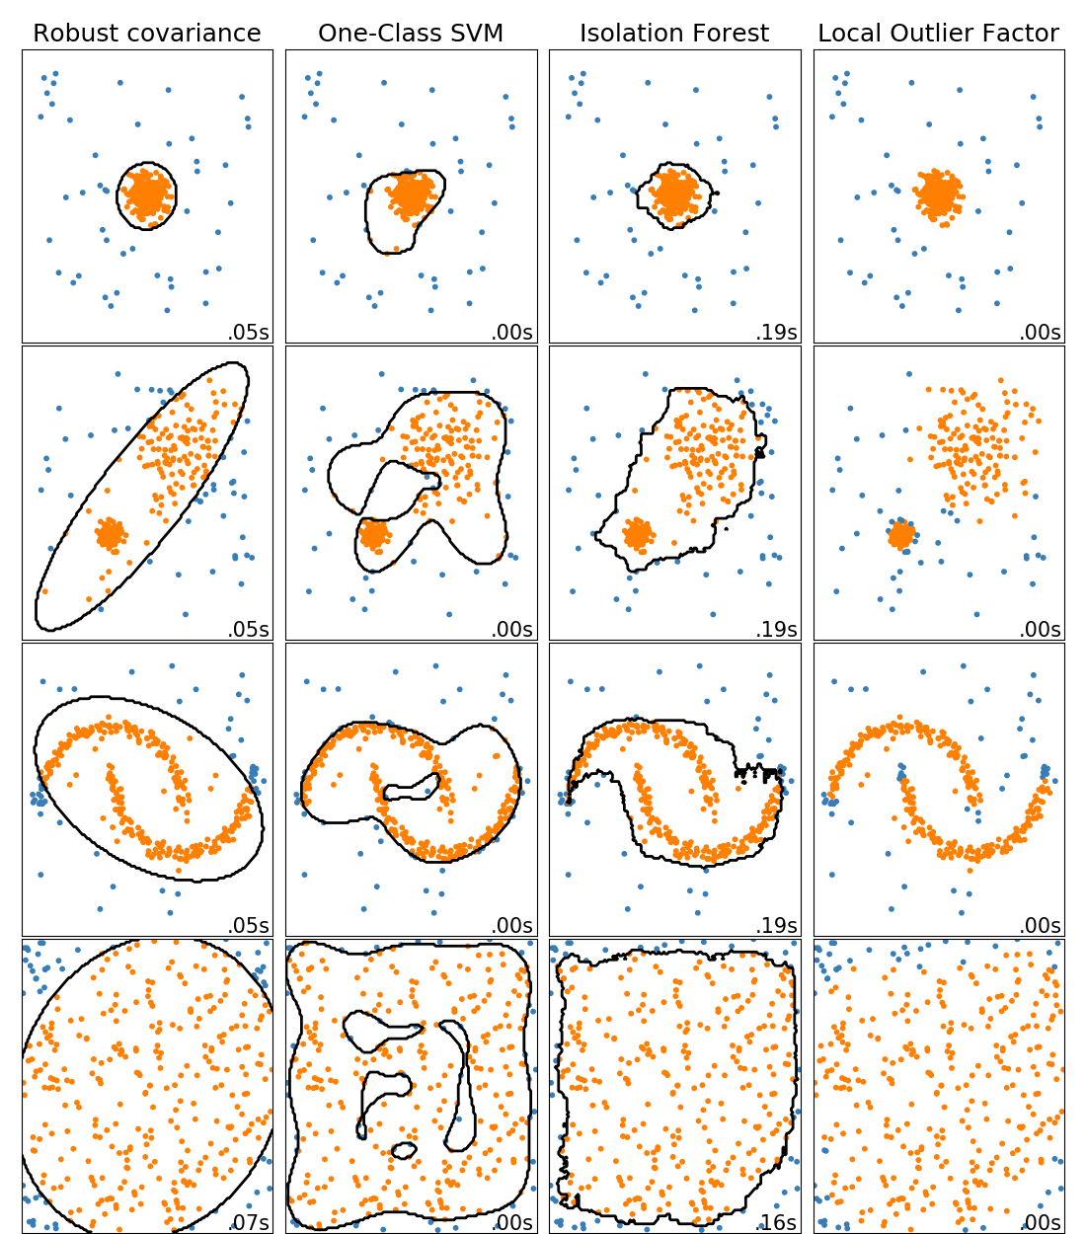
OUTLIER DETECTION ALGORITHMS
Notes:
No assumptions about distribution
Contamination parameter
High dimensionality

Slide 7
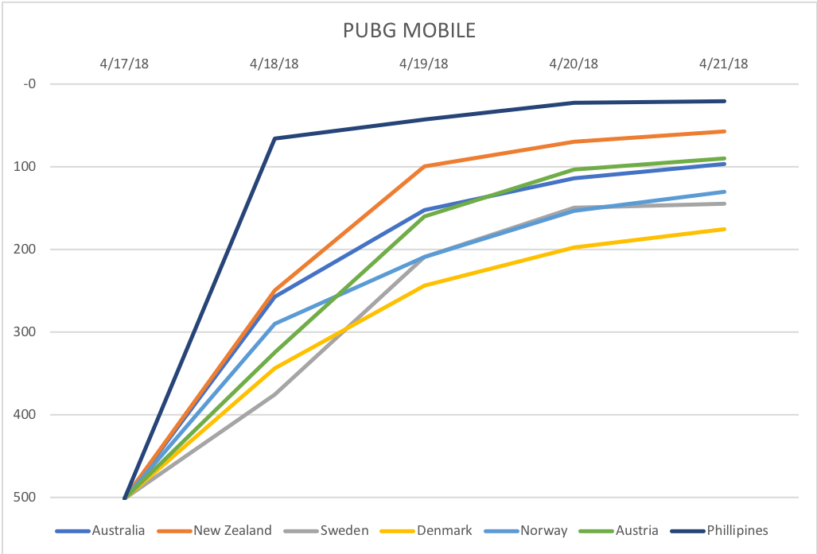
Android Trending App

Slide 8
PROJECT TIMELINE
Sprint 1: Zach (1/31-2/26) web-scrape the data, put it into database, design the database architecture
Sprint 2: Kate (2/27-4/1) Create DataFrames, model the data, build predictive models
Sprint 3: Katie (4/2-5/2) Wrap up, combine python scripts into one, build slack bot

Slide 9
Challenges and triumphs
Incorrectly formatted JSON files
Bug in Google Play Scraper
Learning many new technologies

Slide 10
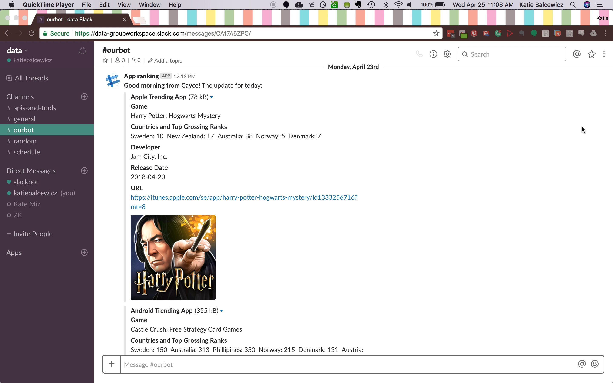

Slide 11
MANY THANKS
ETHAN LEVY & N3TWORK
DR. PAUL ANDERSON
THE DEPARTMENT OF COMPUTER SCIENCE

Slide 12
Thank you for your Attention

